Slide 1
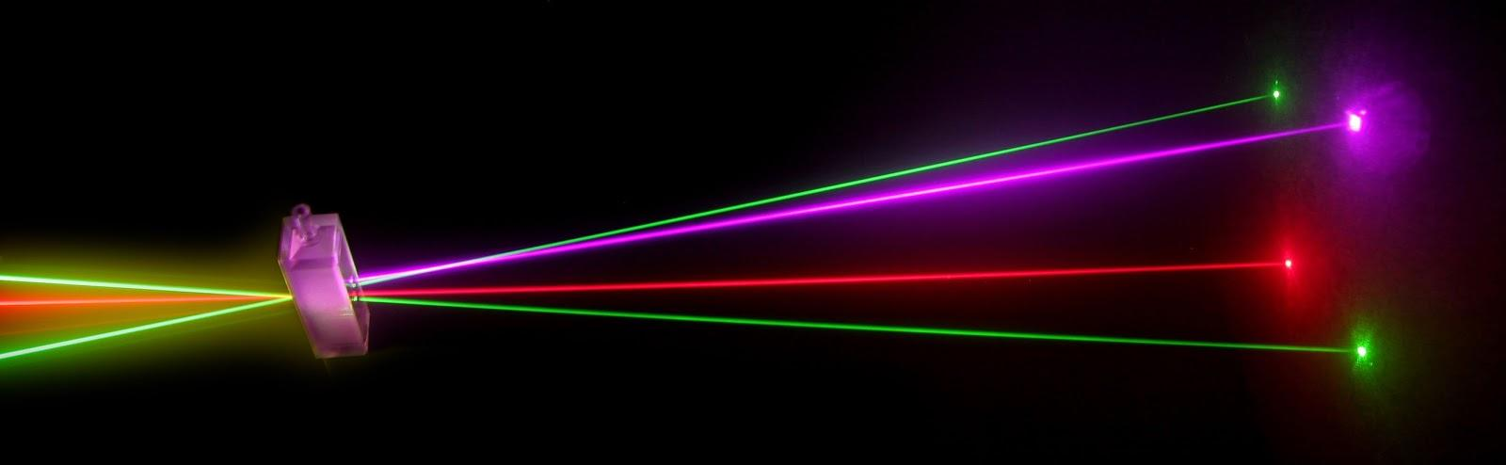
“Laser Technology and Applications” 16B1NPH533 Lecture 38
Carbon dioxide laser
Excimer laser
Chemical Laser

Slide 2
Carbon Dioxide (CO2 ) Laser
CO₂ laser: One of the most powerful & efficient lasers
A four level molecular laser
Operates on a set of vibrational-rotational transitions
Output in mid IR-region at 10.6 μm and 9.6 μm
Both CW and pulsed modes;
CW power output >100kW and pulsed energies as much as 10kJ

Slide 3
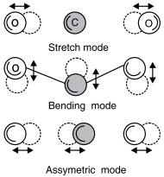
Carbon Dioxide (CO2 ) Laser
Energy levels of CO₂ molecules
Complex energy spectrum of molecules.
Three independent vibrational oscillations – Vibrational modes.
Stretching mode,
Bending mode and
Asymmetric stretching mode
Each mode is quantized; molecules can have 0,1,2 units of vibrational energy in each mode
Each energy state represented by three quantum numbers (m n q) represent the amount of energy associated with each mode. e.g.. (0 2 0) pure Bending Mode with two units of energy.

Slide 4
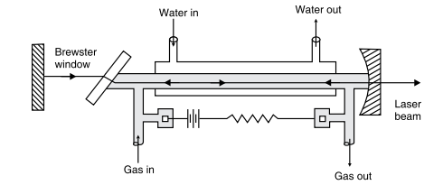
A discharge tube having a bore of cross-section 1.5 cm² & length about 26 cm
Tube filled with a mixture of CO₂, N₂ & He gases in 1:4:5 proportions.
A high DC voltage causes an electric discharge to pass through the tube
Discharge breaks down CO₂ molecules to O & CO
A small amount of water vapor added to gaseous mixture to regenerate CO₂ gas.

Slide 5
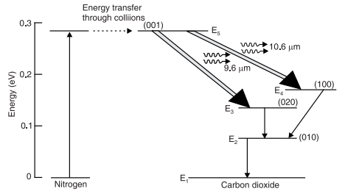
In CO₂ laser, N₂ plays the same role as He in He-Ne laser
Readily transfer of energy by N₂ to CO₂ molecules in resonant collisions.
CO2 at E4 & E3 drops to E2 through inelastic collision with He atoms
He-atoms help to depopulate level E₂ through collisions.
Lasing transitions:
E₅→E₄ transitions at 10.6 µm ;
E₅ → E₃ transitions at 9.6 µm

Slide 6
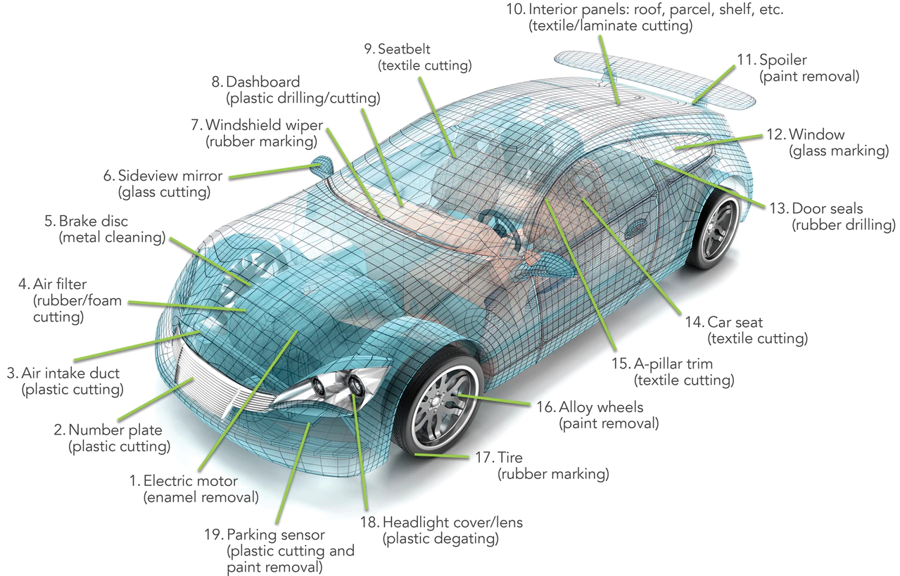


19 Applications on Luxinar Co2 Lasers on a car

Slide 7
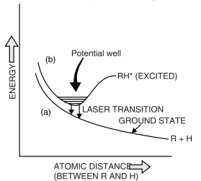
Excimer Lasers
First demonstrated in mid 1970s; Most powerful UV laser
**Active Medium with Diatomic Molecules:**
- **Ground and Excited States:**
- Diatomic molecules form an active medium in the excited state.
- In the ground state, they exist as repelling monomers.
- **Excitation and Forces:**
- Excitation changes atomic states, leading to attractive forces.
- **Excimers:**
- Molecules in the excited state, known as Excimers.
- **Binding Inert Gases:**
- Inert gas atoms can bind to molecules with added energy.

Slide 8
- **Excimer State:**
- A metastable state with multiple vibrational levels.
- **Excitation Process:**
- Short, intense electric discharge through desired gas mixture.
- Electrons transfer energy, creating excited molecules.
- **Population Inversion and Laser Operation:**
- Population inversion occurs as atoms form excited-state molecules.
- Molecules dropping to lower levels separate into atoms, leaving lower levels vacant.
- **Excimer Lasers:**
- High gain, no cavity mirrors needed.
- Uses one fully reflective mirror in the rear and an unsilvered transparent window as the output mirror.

Slide 9
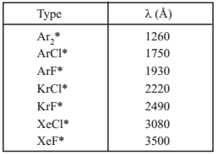
Examples of active medium for Excimers
An excited rare gas dimers; Ar₂*, Kr₂*, Xe₂*
A rare gas oxides; ArO*, KrO*, XeO*
A rare gas atoms in combination with a halide; ArF*, KrF*, XeCl*
Major Applications:
Mainly used in refractive vision correction of Eye (LASIK,PRK)
Manufacturing of semiconductor devices, Photolithography
Material processing
Pumping of dye lasers

Slide 10
Chemical Lasers
Pumped by energy liberated in a chemical reaction
HF (Hydrogen Fluoride ) ⇒ Output wavelength range 2.6 to 3.3 μm
DF (Deuterium Fluoride) ⇒ Output wavelength range 3.5 to 4.2 μm
Primarily developed for military and space applications where pumping
power in form of electrical energy may not be available.
Produces powers of several megawatts (MW)
HF Lasers
Ingredients: molecular Hydrogen and Fluorine gas; He added as buffer gas
Molecular species react at normal temperatures under external excitation such as UV radiations.

Slide 11
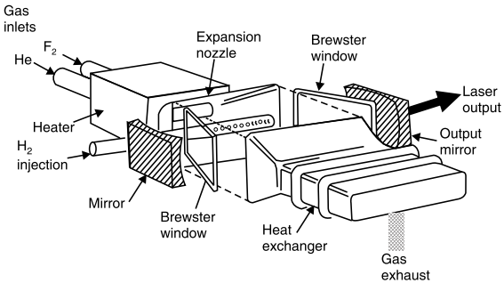
Reaction; Highly Exothermic
Excess energy is equivalent to pumping energy- enormous compared to other forms of pumping energies.
Reaction between atomic and molecular H & F gases
F+H₂ → HF*+H ; ΔH = -31.7 kcal/mole
H+F₂ → HF* +F ; ΔH = -97.9 kcal/mole
Reaction produces vibrationally excited HF* molecules
⇒ Lasing action
End product contains atomic H
and F
Once reaction starts, it continue until all the molecular H2 & F2 are consumed.
Main Application: High power weapons on battle field or in space.

